Slide 1

Rationale
Introduction to Windows Store App Development Using HTML5 and JavaScript
Computer science is a field of study that deals with solving a variety of problems by using computers.
  To solve a given problem by using computers, you need to design an algorithm for it.
Multiple algorithms can be designed to solve a particular problem.
An algorithm that provides the maximum efficiency should be used for solving the problem.
  The efficiency of an algorithm can be improved by using an appropriate data structure.
Data structures help in creating programs that are simple, reusable, and easy to maintain.
This module will enable a learner to select and implement an appropriate data structure and algorithm to solve a given programming problem.

Slide 2
Objectives
  In this session, you will learn to:
  Implement tile notification
Notes:
2

Slide 3

Implementing Tile Notifications
Let us view an animation, which introduces notifications

Slide 4

Introduction to Tile
  When an app is installed on a device, the default tile is displayed for the app on the Start screen.
  The following figure shows the default tile that contains a logo and the name of the app.

Slide 5
Introduction to Tile (Contd.)
  To change the default structure of the tile:
Define the content of the tile in the package.appxmanifest file:
By selecting the logo image to be displayed on the tile.
By setting the size of a tile for an app that can be in two sizes, square and wide.

Slide 6
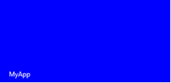
Introduction to Tile (Contd.)
  By default, the tiles are displayed in the square shape.
  To set the wide tile for an app specify the wide logo image in the manifest file.
  The following figure shows a wide tile with the name of the app.

Slide 7
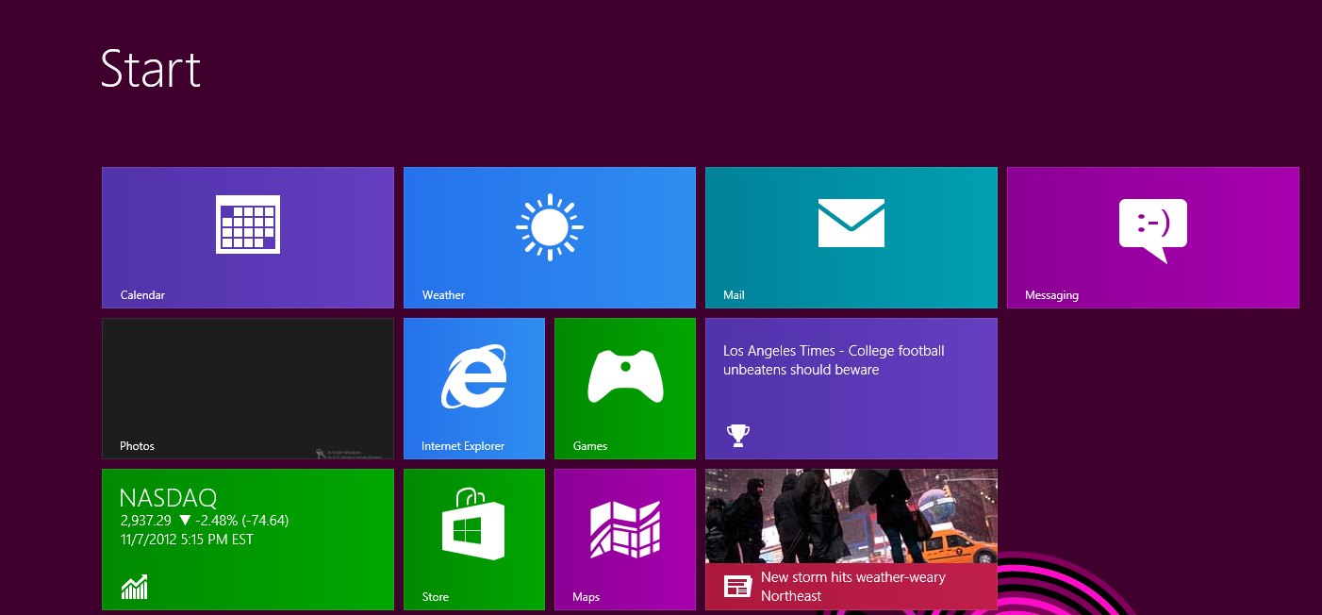
Introduction to Tile (Contd.)
  The following figure shows the Start screen with both the tiles, square and wide.

Slide 8
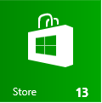
Introduction to Tile (Contd.)
  In the lower right corner of a tile, you can display the status badge.
  It displays the information specific to an app, such as:
  Number of unread emails in a mail app.
  Number of unread messages in a message app.
  Number of updates in a social networking app.
  The following figure shows a numeric badge in a tile.

Slide 9

Introduction to Tile Templates
  Tile templates are provided to set what should appear in the notification.
  These template can have a single frame or two frames.
  A template with two frames placed one above the other is called a peek template.
  The following figure shows a peek template.

Slide 10

Introduction to Tile Templates (Contd.)
  The following figure shows a single-frame template.
  The content displayed on a tile is defined in an XML document and is based on a template.
  These templates define the look and feel of the tiles.

Slide 11
Introduction to Tile Templates (Contd.)
  The following types of templates can be used for the square tiles:
Square text-only templates
TileSquareBlock
TileSquareText01
TileSquareText02
TileSquareText03

Slide 12

Introduction to Tile Templates (Contd.)
Square image-only templates
TileSquareImage

Slide 13
Introduction to Tile Templates (Contd.)
Square peek templates
TileSquarePeekImageAndText01
TileSquarePeekImageAndText02
TileSquarePeekImageAndText03
TileSquarePeekImageAndText04

Slide 14

Just a Minute
  Identify the square tile template that divides the tile into two frames.
  1. Square text-only templates
  2. Square image-only templates
  3. Square peek templates

Slide 15
Just a Minute (Contd.)
  Solution:
  3. Square peek templates

Slide 16
Introduction to Tile Templates (Contd.)
  The following types of templates can be used for the wide tiles:
Wide text-only templates
TileWideText01
TileWideText02

Slide 17
Introduction to Tile Templates (Contd.)
Wide image-only templates
TileWideImage
TileWideImageCollection

Slide 18
Introduction to Tile Templates (Contd.)
Wide
image-and-text templates
TileWideImageAndText01
TileWideImageAndText02

Slide 19
Introduction to Tile Templates (Contd.)
Wide peek templates
TileWidePeekImageCollection01
TileWidePeekImageCollection02

Slide 20
Summary
  In this session, you learned that:
  When an app is installed on a device, a default tile is displayed for the app on the Start screen.
  In the lower right corner of the tile, you can display the status badge.
  A template with two frames placed one above the other is called the peek template.
Notes:
20

Slide 21

Q&A

